Slide 1
PlagiaBust - Plagiarism Detection Framework

Slide 2

The Team
Group Members
Project Supervisors
Udana Costa
Nuwan Senevirathna
Isuru Wijesinghe
Kasun Jayasinghe
Dr. Malaka Walpola
Mr. Chulaka Gunasekara

Slide 3
Flow of the Presentation
Plagiarism
What is PlagiaBust
Overview of PlagiaBust
Research Conducted
Technologies and Methods
Features
Q & A

Slide 4
Plagiarism
Plagiarism is the unauthorized use of others work without acknowledgment.
Availability of Internet materials has made it easy for students to plagiarize from Internet resources.
Huge threat to intellectual property of original authors.

Slide 5
What is PlagiaBust?
A free and open source Plagiarism detection software.
Based on text mining techniques.
Developed using Java based technologies and tools.

Slide 6
Features
Plagiarism detection for a single document.
Plagiarism detection for a set of peer documents.
Copy paste Plagiarism detection.
Paraphrase Plagiarism detection.
Detection of Internet Plagiarism.
Detection of PlagiaBust server sources.

Slide 7
Features (Cont..)
Rich user experience.
Supports for most commonly used document types.
Graphical representation of Plagiarism detection results using
Document comparison window
Connectivity Graphs
Internet source browser
Comprehensive and exportable final report

Slide 8
Overview of the PlagiaBust System
Data Extraction Module
PlagiaBust Server Sources Detection Module
Data Preprocessing Module
External Source Detection Module
Matching Engine
Internet Source Detection Module
Reporting Generator Module
Storage Interface
Storage

Slide 9
Research And Development
Data Extraction Module
PlagiaBust Server Sources Detection Module
Data Preprocessing Module
External Source Detection Module
Matching Engine
Internet Source Detection Module
Reporting Generator Module
Storage Interface
Storage

Slide 10
Data Extraction Module R&D
Document Type Support
Convert all document formats into text format
(pdf, doc, docx, rtf, txt)
PDF - Apache PDF Box version 0.7.3
MS Word formats - docx, doc - Apache POI 3.7
rtf – RTFEditorKIT java 1.6.0

Slide 11
Research And Development
Data Extraction Module
PlagiaBust Server Sources Detection Module
Data Preprocessing Module
External Source Detection Module
Matching Engine
Internet Source Detection Module
Reporting Generator Module
Storage Interface
Storage

Slide 12
External Source Detection R&D
Query Selection Algorithms – Using Plagiabust Testing Framework
Exhaustive selection
Flesch-Kincaid Grade Level
Random selection
Paragraph wise query selection
Internet Search
Querying using Bing search
Querying using Google search
PlagiaBust Web Search Service
Apache Solr

Slide 13
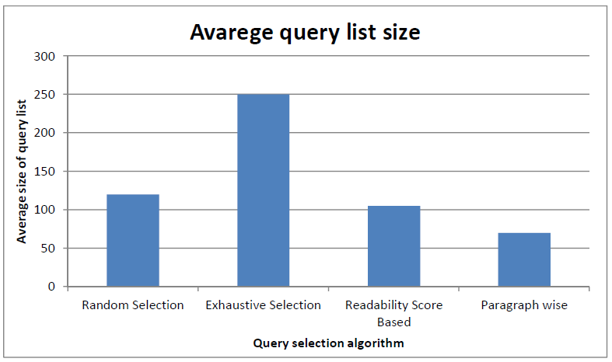
External Source Detection R&D
Query Selection Algorithm
Paragraph wise query selection
Testing Corpus - set of 100 documents, each contain approximately 3000 words

Slide 14
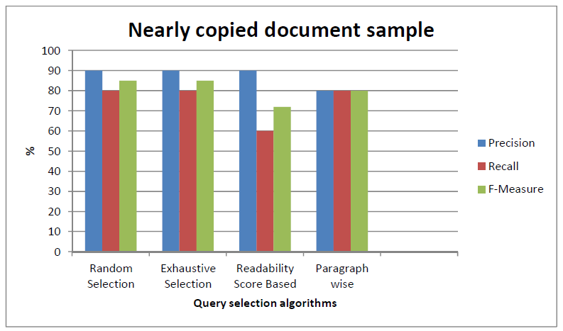
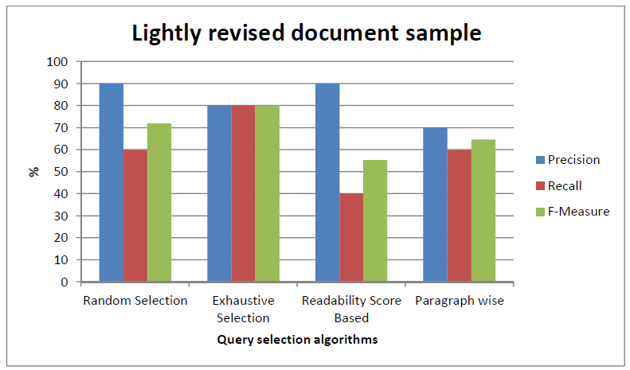
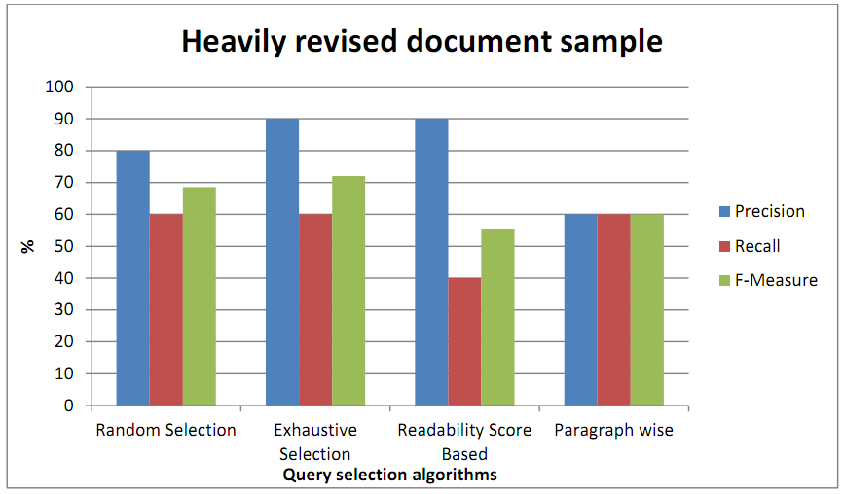
External Source Detection R&D

Slide 15
External Source Detection R&D
Internet Live Search Services – Bing Search API, Google Search API
Peer Document Filtering – using Apache Lucene 2.9
Narrow down the document search space
PlagiaBust Web Search Service – using Apache Solr
An alternative for Internet Search Services

Slide 16
Research And Development
Data Extraction Module
PlagiaBust Server Sources Detection Module
Data Preprocessing Module
External Source Detection Module
Matching Engine
Internet Source Detection Module
Reporting Generator Module
Storage Interface
Storage

Slide 17
Technologies and Methods Used
Document Type Support
Convert all document formats into text format
(pdf, doc, docx, rtf, txt)
PDF - Apache PDF Box version 0.7.3
Docx, Doc - Apache POI 3.7

Slide 18
Research Conducted
Data Preprocessing
Stemming Algorithms
Martin Porters Algorithm
Lovins Algorithm
Stop Words Removal
Apache Lucene StopAnalyzer
Apache Lucene SnowballAnalyzer
Synonym Replacement
WordNet - lexical database for the English language
JWNL (Java WordNet Library)
JWI (MIT Java Interface to Wordnet)
Lucene – WordNet (Apache lucene team)

Slide 19
Overview of the PlagiaBust System
Data Extraction Module
PlagiaBust Server Sources Detection Module
Data Preprocessing Module
External Source Detection Module
Matching Engine
Internet Source Detection Module
Reporting Generator Module
Storage Interface
Storage

Slide 20
Technologies and Methods Used
Textual Similarity Comparison
Comparison Algorithm - ShingleCloud Approach
Document Chunking – n-gram Chunking
Size of a N-Gram
Minimal number of ones in a match
Maximum number of zeros in a match

Slide 21
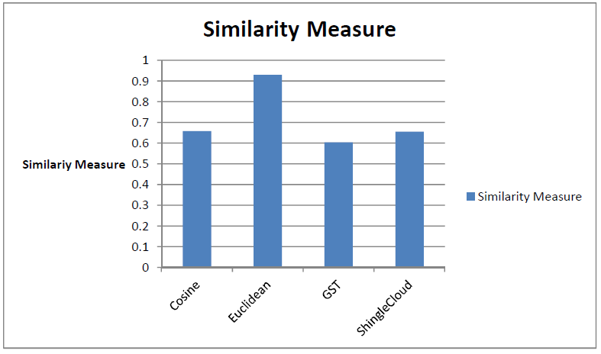
Technologies and Methods Used
Textual Similarity Algorithms Comparison

Slide 22
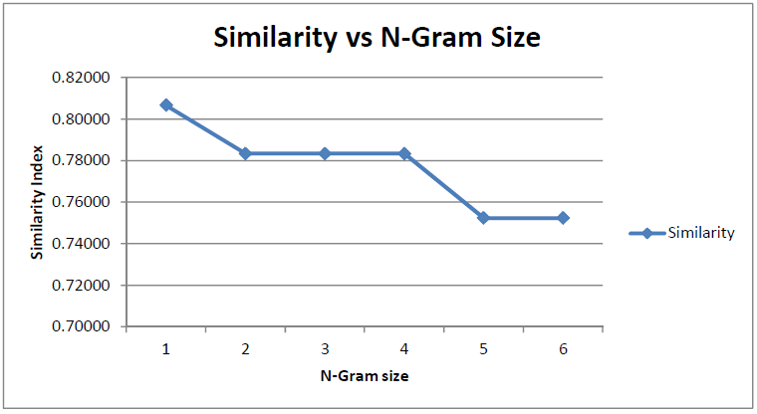
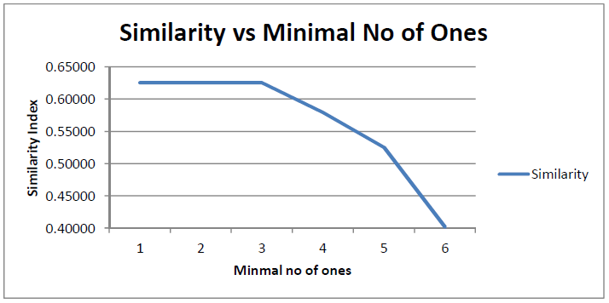
Technologies and Methods Used
ShingleCloud Algorithm Input Parameters Selection

Slide 23
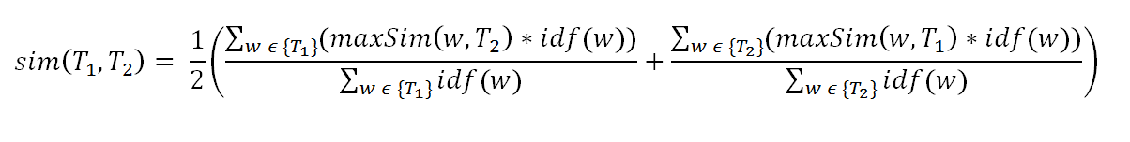
Technologies and Methods Used
Paraphrase Detection
Algorithm– Sementic Similarity calculation
Testing Corpus - Microsoft Research Paraphrase Corpus
contains 5801 pairs of sentences obtained from online news articles referring to same event
approximately 67% of the 5,801 pairs were judged to be paraphrases.

Slide 24
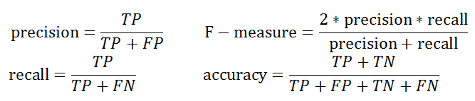
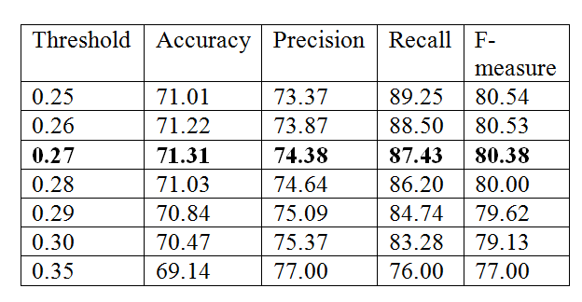
Technologies and Methods Used
Paraphrase Detection
Accuracy Measures
Threshold value selection

Slide 25
Technologies and Methods Used
Comparison with available methods
Method | Accuracy (%) | Precision (%) | Recall (%) | F-measure (%)
Corley &Mihalcea (2005)[1] | 71.5 | 72.3 | 92.5 | 81.2
Das & Smith (2009)[2] | 76.1 | 79.6 | 86.1 | 82.9
Finch et al. (2005)[3] | 75.0 | 76.6 | 89.8 | 82.7
Malakasiotis (2009)[4] | 76.2 | 79.4 | 86.8 | 82.9
Qiu et al. (2006)[5] | 72.0 | 72.5 | 93.4 | 81.6
Wan et al. (2006)[6] | 75.6 | 77.0 | 90.0 | 83.0
Zhang & Patrick (2005)[7] | 71.9 | 74.3 | 88.2 | 80.7
Our Method | 71.31 | 74.38 | 87.43 | 80.38
BASE1 | 66.5 | 66.5 | 100.0 | 79.9
BASE2 | 69.0 | 72.4 | 86.3 | 78.8

Slide 26
Research And Development
Data Extraction Module
PlagiaBust Server Sources Detection Module
Data Preprocessing Module
External Source Detection Module
Matching Engine
Internet Source Detection Module
Reporting Generator Module
Storage Interface
Storage

Slide 27
Research Conducted
Matching Engine
Copy-Paste Detection
Cosine Similarity
Euclidean Distance
Greedy String Tiling Algorithm
ShingleCloud Approach
Paraphrase Detection
Text Semantic Similarity Calculation
Recognition Approaches uses Surface Text Similarity
Recognition Approaches Based on Syntactic Similarity
Recognition Approaches that Employ Machine Learning

Slide 28
Technologies and Methods Used
Reporting Module
Java Swing Framework
Final Report - Jasper Reports Java library
Exporting capability to Pdf,Doc,HTML etc.
Connected Graph View of the Plagiarism Results - JUNG graph plotting library
Vertices- Documents
Edges- The connection between documents-
Text Highlighting – Java Highlighter, Regular Expressions

Slide 29
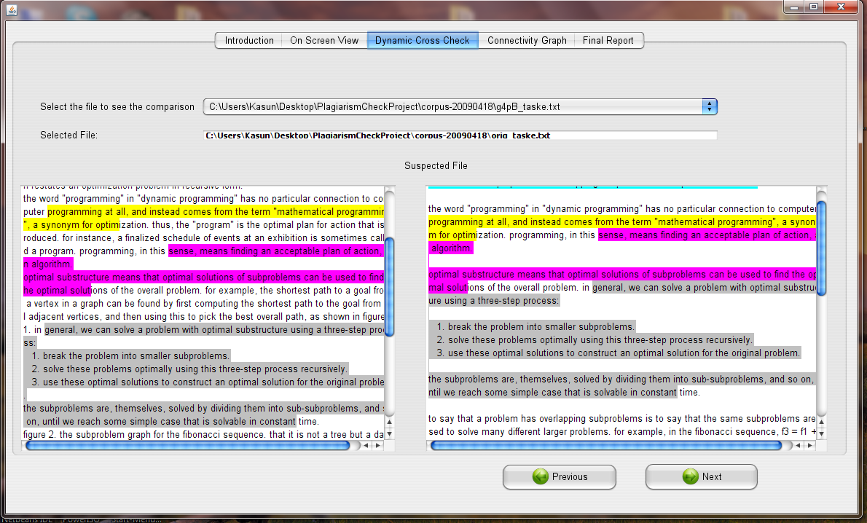
Core Features
Document comparison window

Slide 30
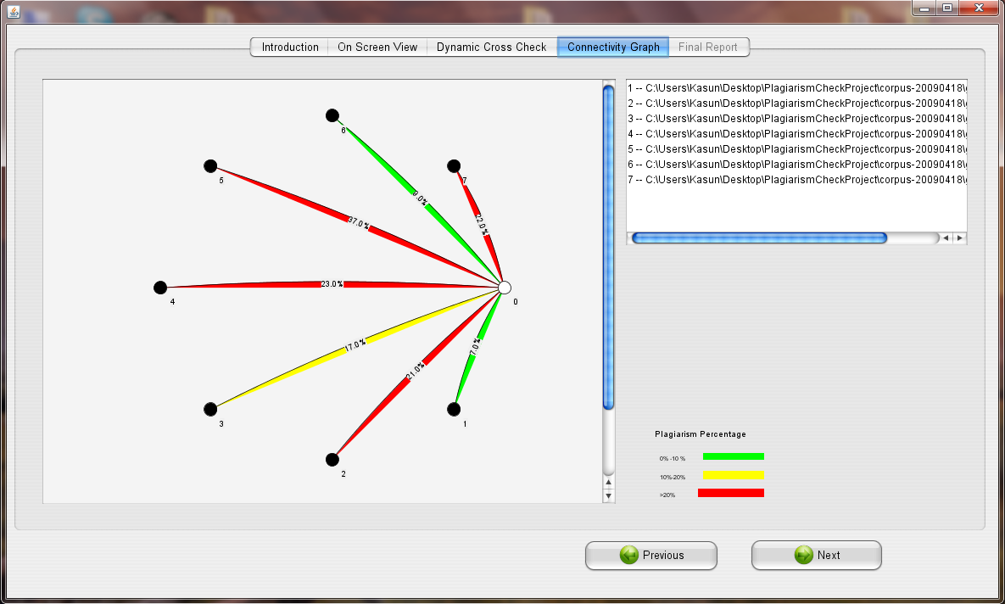
Core Features
Connectivity Graph

Slide 31
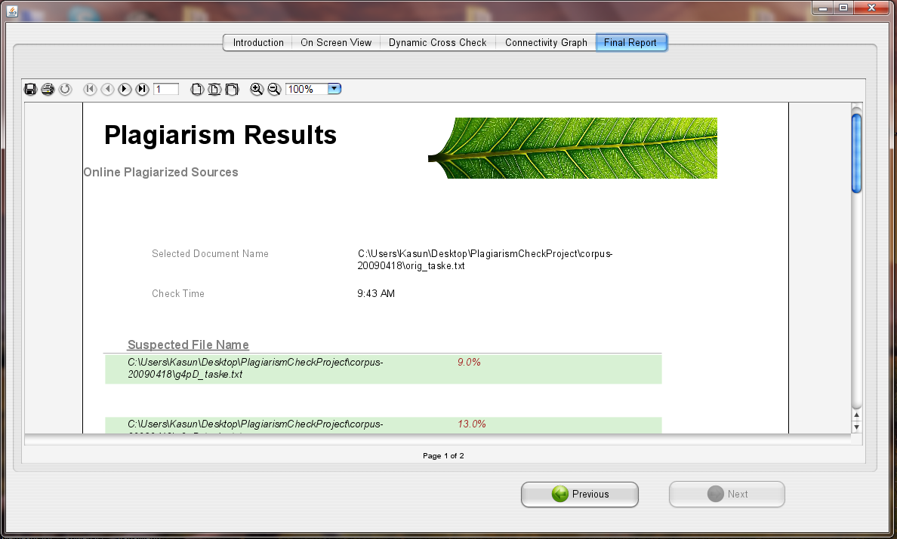
Core Features
Plagiarism Report

Slide 32
Q & A

Slide 33
Thank You

